Slide 1
Blockchain-Based Personal Health Data Sharing System
Enhancing Privacy and Collaboration in Healthcare
Tithi Jhamnani
D17B
31

Slide 2
AGENDA
Introduction to the research
System Entities
System Implementation
System Evaluation
Related Work
Conclusion and Future Work

Slide 3
INTRODUCTION
Introduction to the Importance of Personal Health Data Sharing
Improved healthcare
Benefits for care providers and research
Challenges in Current Systems
Privacy
Security
Interoperability
The Need for User-Centric Access Control and Privacy Preservation

Slide 4
BLOCKCHAIN
What is Blockchain?
Blockchain technology is an advanced database mechanism that allows transparent information sharing within a business network.
Key Features
Robustness
Data Provenance
Privacy and Pseudonymity
Importance in Healthcare - In healthcare, Blockchain has a wide range of applications and functions. The ledger technology helps healthcare researchers uncover genetic code by facilitating the secure transfer of patient medical records, managing the drug supply chain, and facilitating the safe transfer of patient medical records.

Slide 5
SYSTEM ENTITIES
User: Owner of personal health data, control over data access
Wearable Device: Data collection and synchronization
Healthcare Provider: Access to user data with permission
Health Insurance Company: Data for policy creation with user consent
Blockchain Network: Integrity and trust
Cloud Database: Data storage and accountability

Slide 6
PERSONAL HEALTH DATA COLLECTION
How Data is Collected
Wearable devices
Medical devices
Manual input
Data Synchronization to the Cloud
User Ownership and Control Over Data

Slide 7
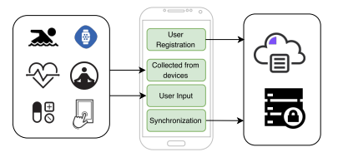
PERSONAL HEALTH DATA COLLECTION

Slide 8
DATA INTEGRITY PROTECTION
Data Flow: Device to Cloud, Anchored on Blockchain
Merkle Tree for Scalable Data Processing
Chainpoint for Timestamped Proofs
Ensuring Data Integrity

Slide 9
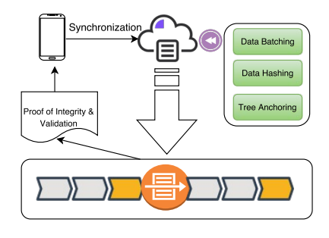
DATA INTEGRITY PROTECTION

Slide 10
DATA SHARING AND HEALTHCARE COLLABORATION
User's Ability to Share Data
Event Recording and Blockchain Transactions
Access Control Scheme
Fine-Grained Privacy Protection

Slide 11
DATA SHARING AND HEALTHCARE COLLABORATION
HEALTH DATA | OPERATOR | OPERATION
Personal health data | User Healthcare provider Insurance company | Update, Query Query Query
Medical history | Healthcare provider User Insurance company | Update, Query Query Query
Insurance information | Insurance company User Healthcare provider | Update, Query Query Query

Slide 12
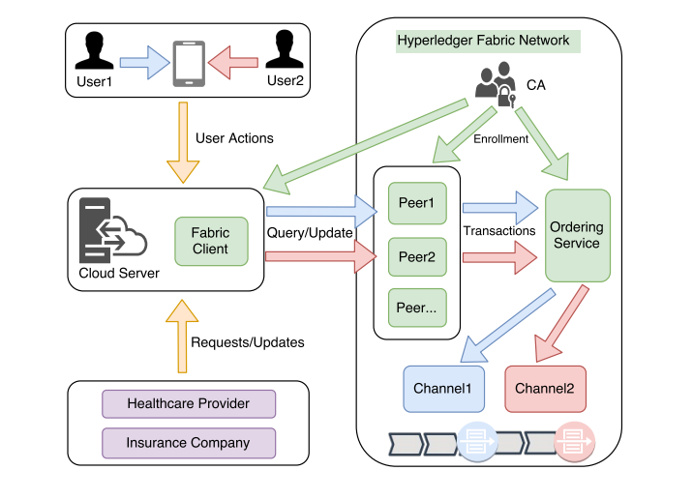
DATA SHARING AND HEALTHCARE COLLABORATION

Slide 13
SYSTEM IMPLEMENTATION
Overview of System Implementation - adopts a user-centric model for processing personal health data using blockchain network, ensuring the data ownership of individuals, as well as data integrity
Utilizing Hyperledger Fabric - Hyperledger Fabric is a blockchain framework for business applications. It's employed to create private, scalable, and secure distributed ledgers, enabling organizations to streamline processes, enhance transparency, and establish trust in complex ecosystems.
Emphasis on Data Ownership and Control

Slide 14
SYSTEM EVALUATION
Evaluation Results - It is crucial to evaluate the system performance, regarding to the scalability and efficiency of the data integrity proof generation and data validation process.
Scalability
Efficiency
Handling Large Datasets
Importance of Efficient Data Processing

Slide 15
CONCLUSION
Conclusion and Future Work
Key Takeaways from the Research
Value of personal health data
Importance of Blockchain technology
User Ownership
Access control

Slide 16
THANK YOU

Slide 17
Research paper
https://drive.google.com/file/d/1cHwwHYQbPhbRWnMuQlxHfTIKMlXEIY1_/view?usp=drivesdk

Slide 18
Smart Contract
1. Data Sharing Smart Contract:
solidity
// SPDX-License-Identifier: MIT
pragma solidity ^0.8.0;
contract DataSharingContract {
address public owner;
mapping(address => bool) public authorizedResearchers;
mapping(bytes32 => bool) public sharedData;
event DataShared(address indexed researcher, bytes32 dataHash);
constructor() {
owner = msg.sender;
}
modifier onlyOwner() {
require(msg.sender == owner, "Only the owner can perform this action");
_;
}
modifier onlyAuthorized() {
require(authorizedResearchers[msg.sender], "You are not authorized to share data");
_;
}
function authorizeResearcher(address researcher) public onlyOwner {
authorizedResearchers[researcher] = true;
}
function revokeAuthorization(address researcher) public onlyOwner {
authorizedResearchers[researcher] = false;
}
function shareData(bytes32 dataHash) public onlyAuthorized {
sharedData[dataHash] = true;
emit DataShared(msg.sender, dataHash);
}
}

Slide 19
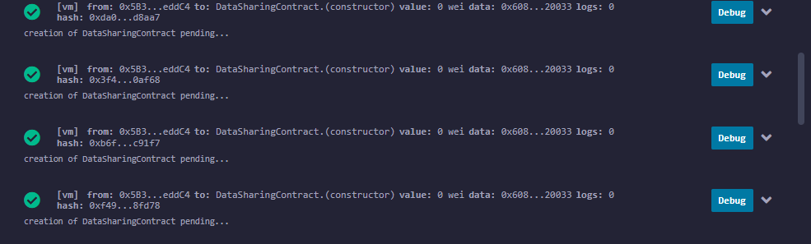
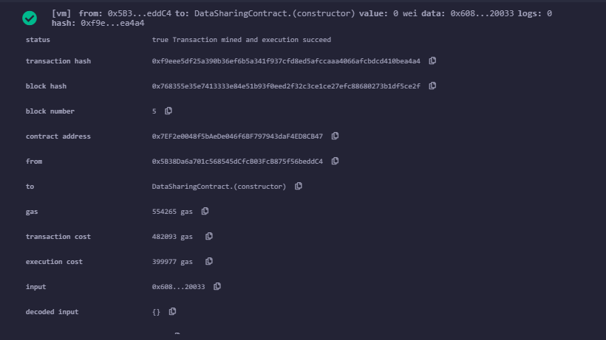

Slide 20
2. Collaboration Smart Contract:
solidity
// SPDX-License-Identifier: MIT
pragma solidity ^0.8.0;
contract CollaborationContract {
address public owner;
mapping(bytes32 => uint256) public collaborationProposals;
event ProposalCreated(bytes32 proposalId, uint256 proposalValue);
constructor() {
owner = msg.sender;
}
modifier onlyOwner() {
require(msg.sender == owner, "Only the owner can perform this action");
_;
}
function createProposal(bytes32 proposalId, uint256 proposalValue) public onlyOwner {
collaborationProposals[proposalId] = proposalValue;
emit ProposalCreated(proposalId, proposalValue);
}
}

Slide 21
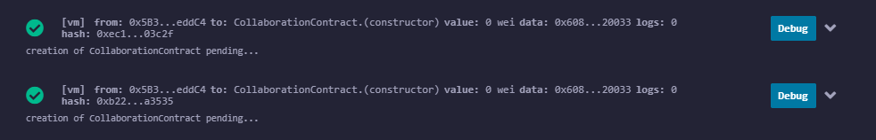
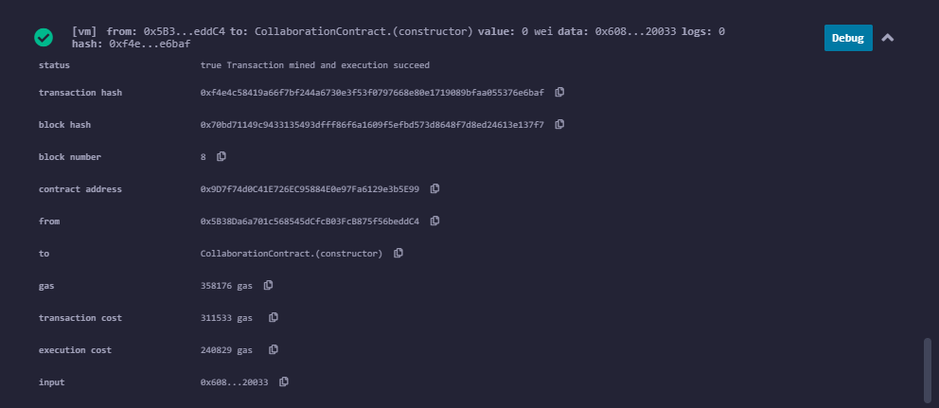

Slide 22
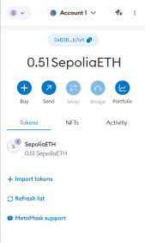
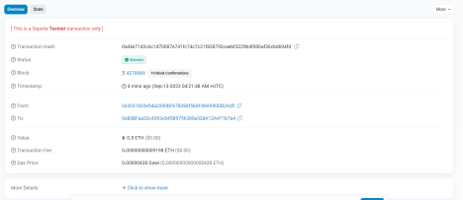
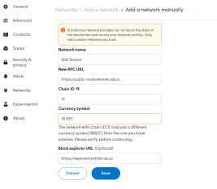
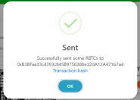

Slide 23
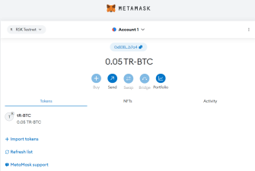
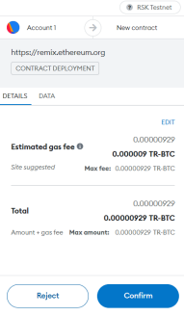

Slide 24
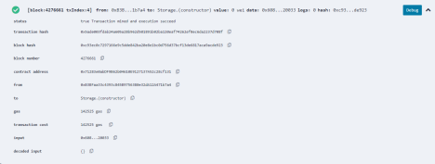

Slide 25
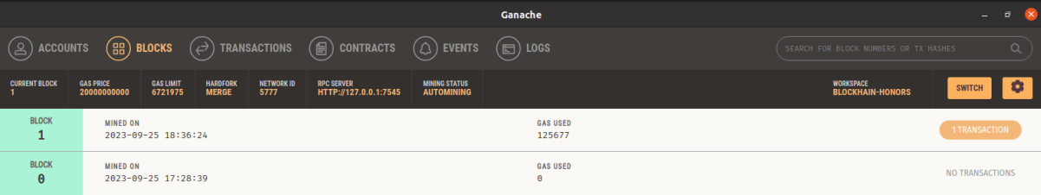
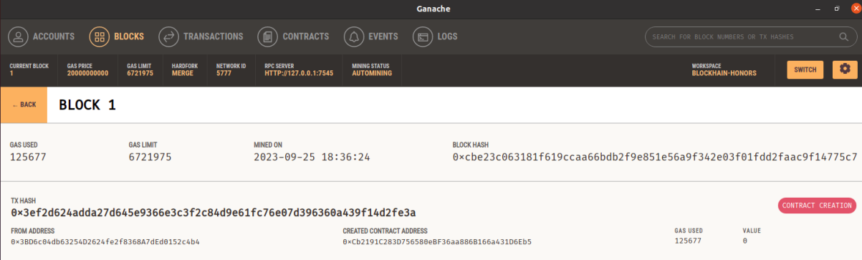
Contents of block1

Slide 26
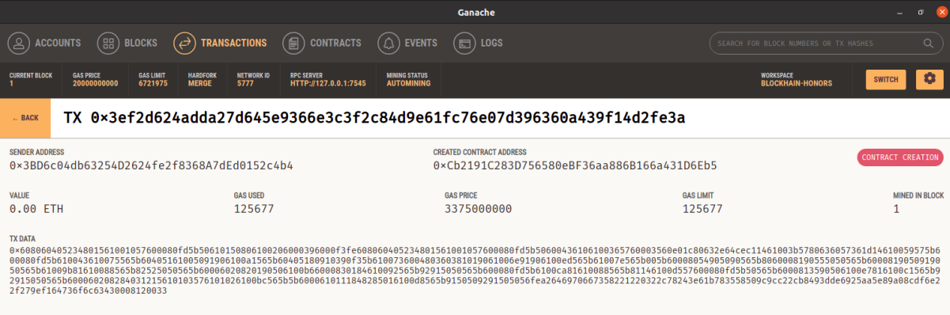

Slide 27
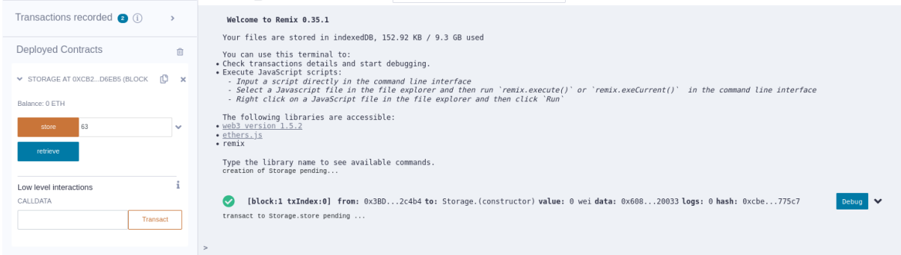

Slide 28
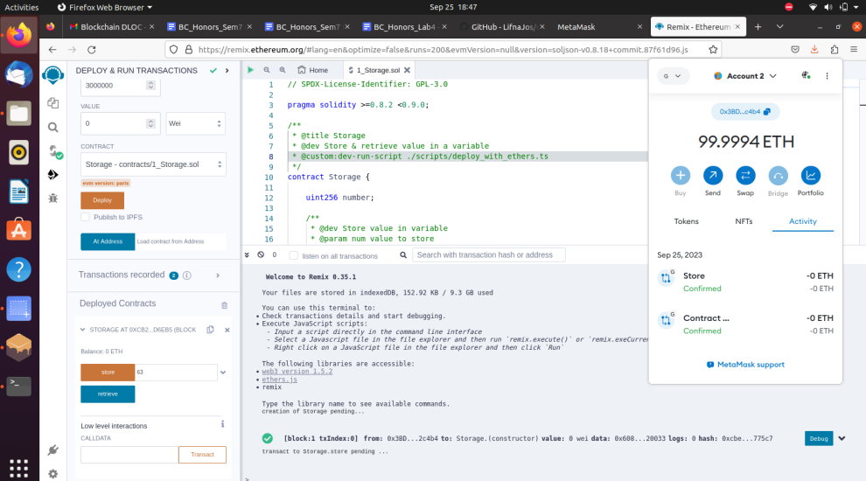

Slide 29
